Slide 1


Department of Electrical and Electronics Engineering
EEB1204-Minor Project IV
Academic Year (2025-2026) - Batch (2024-2028) II Year B Section
End Semester Review
Date : 13.12.2025

Slide 2
TITLE OF THE PROJECT
Title
: LANDSLIDE DETECTOR
Batch Members : | Piragatheshwaran M | (927624BEE072)
 | Sanjai B | (927624BEE084)
 | Shameem I Sibidharan R | (927624BEE088) (927624BEE091)
Guide Name
: Dr. B. Rajesh Kumar, M.E.,Ph.D., ASP/EEE

Slide 3
LIST OF CONTENTS
Advantages
Application
Outcome of the Project
Conclusion
Future Scope
Introduction
Components Used
Block Diagram
Working
Project Overview

Slide 4
INTRODUCTION
A landslide detection system using IoT continuously monitors soil and environmental conditions to identify early signs of slope failure. Sensors such as the MPU6050 gyroscope, vibration sensor, soil moisture sensor, and rain drop sensor gather real-time data, which is processed by an Arduino Uno and sent to the cloud via an ESP8266 module. If any reading crosses a safety limit, the system triggers a buzzer and displays alerts on an I2C LCD, enabling timely warnings and improved disaster prevention.

Slide 5
COMPONENTS USED
Arduino UNO (main controller)
ESP8266
Rain Drop Sensor
Soil Moisture Sensor
I2C LCD Display
Gyroscope MPU6050
Buzzer
Power Adapter
Vibration Sensor

Slide 6
BLOCK DIAGRAM
Sensor Module
Alert Module
Sensing and
Processing
Warning
Output
Arduino UNO
Wifi Module
Cloud Monitoring
Transmit
Receives
Signal
Transmission
of data
Remote Monitoring

Slide 7
WORKING
Sensors collect data: Tilt, vibration, soil moisture, and rainfall sensors continuously monitor the slope conditions.
Arduino analyzes readings: The Arduino checks if any sensor values cross the preset danger limits.
Alerts are triggered: If a risk is detected, the buzzer sounds and the I2C LCD shows a warning message.
Data sent to cloud: The ESP8266 Wi-Fi module uploads sensor data online for remote monitoring and timely action.

Slide 8
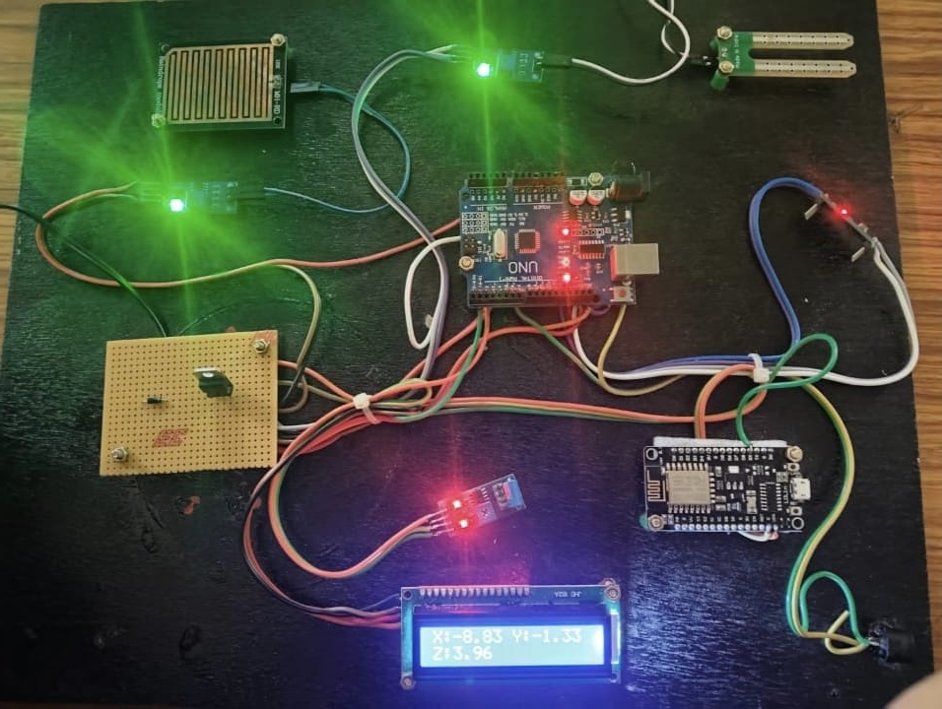
PROJECT OVERVIEW

Slide 9
ADVANTAGES
Early detection of landslide risks, allowing timely preventive action.
Real-time monitoring of soil and environmental conditions for continuous safety.
Remote access to data through IoT, enabling monitoring from anywhere.
Quick and reliable alert notifications during abnormal conditions.
Low-cost and energy-efficient design, making it practical for long-term use.
Improves overall disaster preparedness, reducing potential damage and loss

Slide 10
APPLICATIONS
Monitoring landslide-prone hill and mountain regions
Enhancing safety along highways and roadside slopes
Assessing ground stability at construction sites
Detecting soil movement in mining areas
Monitoring slopes near railway tracks in hilly regions
Supporting disaster management teams with real-time alerts

Slide 11
OUTCOME OF THE PROJECT
The system gives early landslide warnings through real-time sensing and alerts.
It improves safety by enabling quick action and continuous monitoring.
It supports remote monitoring for better disaster preparedness.

Slide 12
CONCLUSION
The IoT-based landslide detection system effectively monitors ground movement, vibration, moisture, and rainfall to identify early signs of slope failure. By providing instant alerts and remote monitoring, it enhances safety, supports timely decision-making, and helps reduce the impact of landslides in vulnerable areas.

Slide 13
FUTURE SCOPE
Integration of advanced sensors for more accurate prediction
Use of machine learning to improve landslide forecasting
Solar-powered operation for usage in remote areas
Mobile app and GIS mapping for better real-time alerts and visualization

Slide 14
THANK YOU

